Slide 1

HL5230-Applied Machine Learning for Health Data Datathon #1
Factors that Influence BMI
Team 20-CHL5230-F23
Hunter Pozzebon
Emily Lau
Arij Al Chawaf

Slide 2
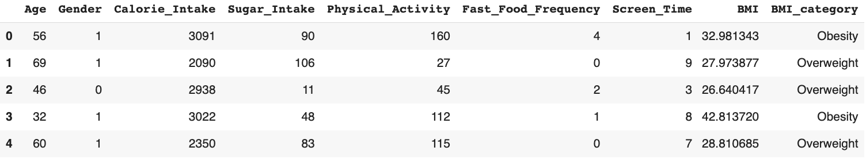
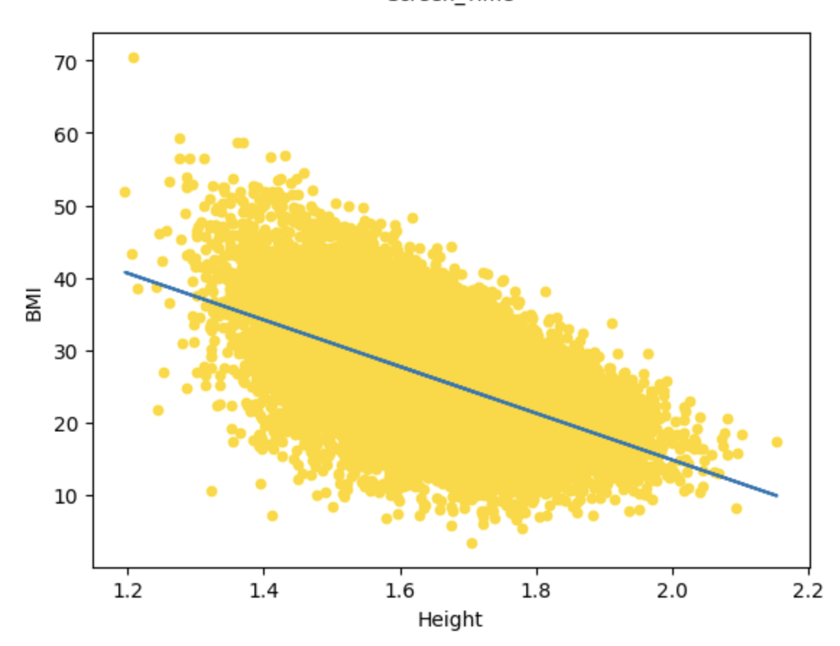
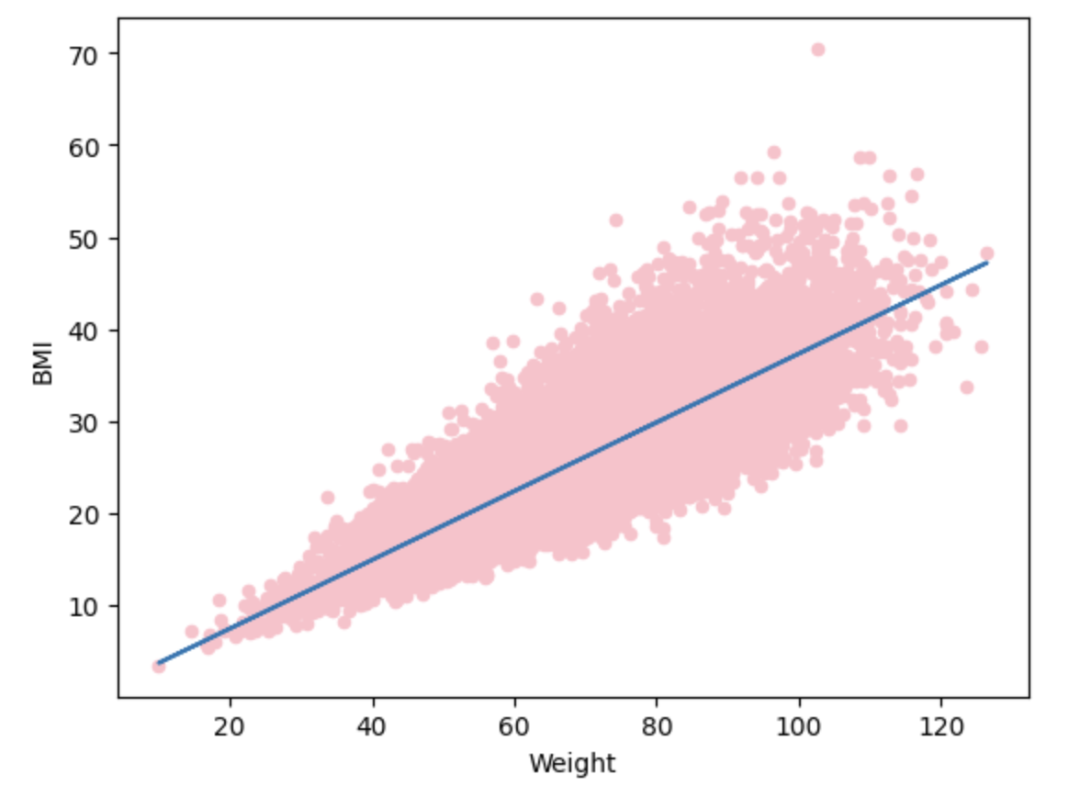
Data Engineering
Questions & Analysis Methods
What factors are associated with BMI? → Regression Analysis
Which factors best predict BMI? → K-NN Analysis
Which factors are related to each other? → K-Means Analysis
Notes:
Recoded Gender from categorical to binary; and BMI continuous -> categorical
For our analysis, we removed the features weight and height because this results in an extremely high accuracy because they are used to directly calculate the BMI

Slide 3
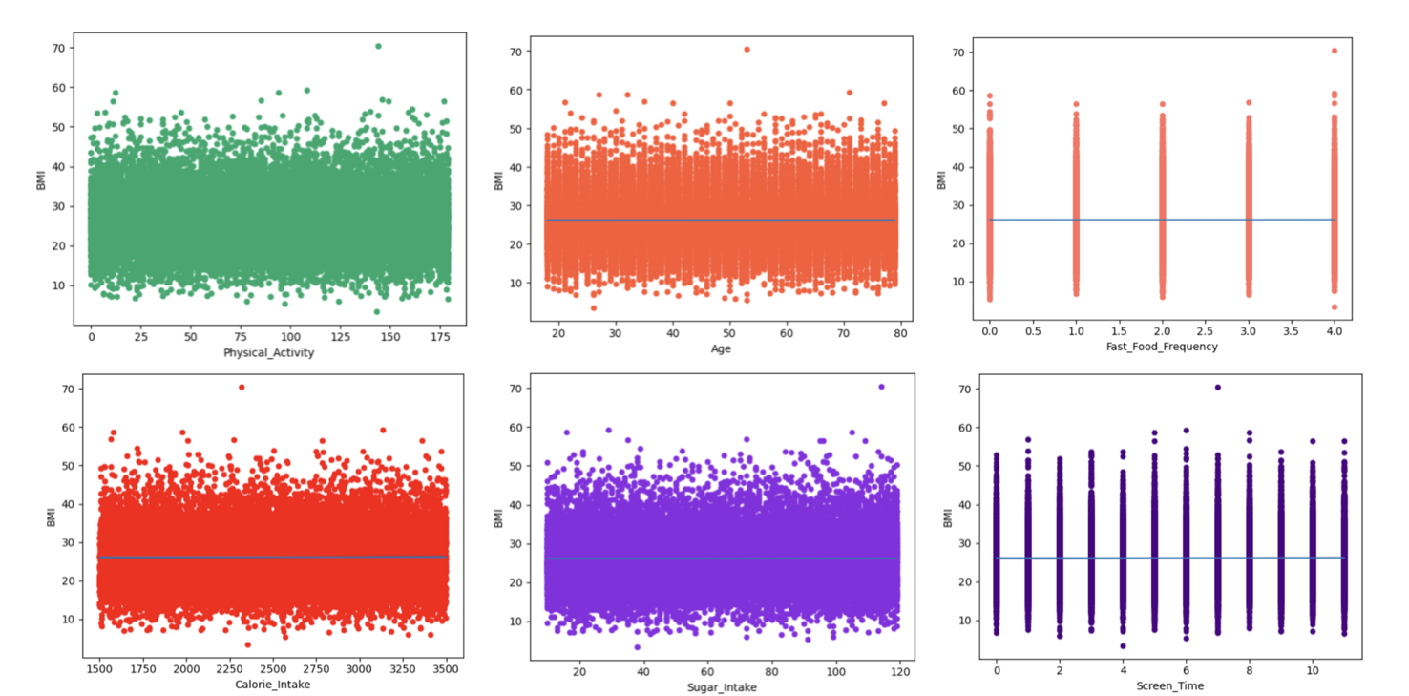
Are any features correlated or associated with BMI?
Regression Analysis
Feature | Estimate | P-Value | Correlation with BMI
Age | -0.000089 | 0.972 | -0.0002
Gender | 0.022469 | 0.809 | 0.0015
Calorie Intake | 0.000062 | 0.423 | 0.0052
Sugar Intake | 0.000465 | 0.74 | 0.0021
Physical Activity | -0.000475 | 0.58 | -0.0036
Fast Food Frequency | 0.012170 | 0.701 | 0.0026
Screen Time | 0.009585 | 0.4603 | 0.0048
Notes:
What we did
Descrbe()
Corr()
Plotted scatterplots
Linear regression analysis
Results
Nothing is associated
Nothing is strongly correlated

Slide 4
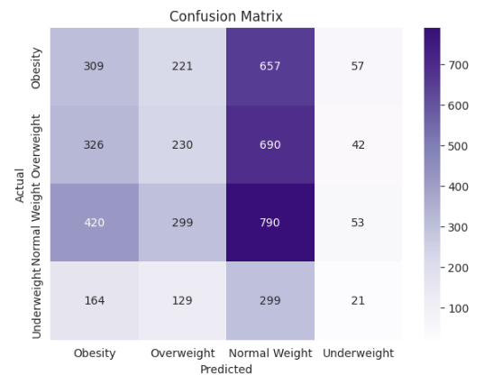
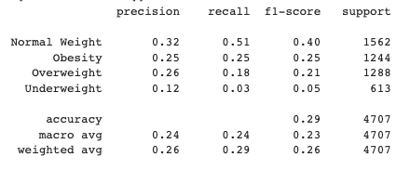
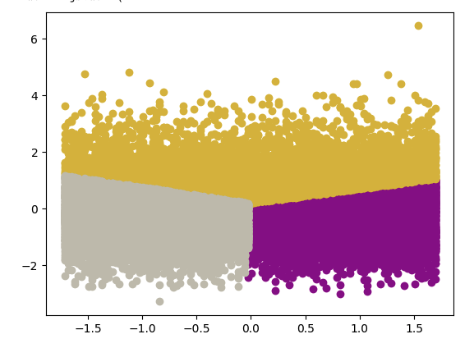
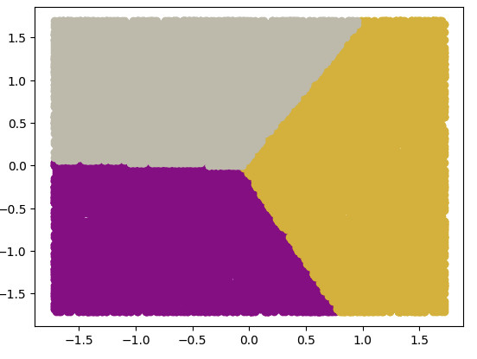
Which features best predict a high BMI?
Are any features related to each other?
K-NN Model Results
K-Means: Sugar_Intake & BMI, K=3
K-Means: Sugar_Intake & Physical_Activity, K=3
Notes:
For K-NN model, all features but height and weight were used.
Results showed that the model has low precision and accuracy in general.
The poor accuracy and precision of this model is also reflected in the confusion matrix where there are many false positives and false negatives.

